Slide 1

Exploratory Data Analysis on 1000 Movies Data By-Monali Tatte

Slide 2
Problem Statement
Aim: Produce Movies that earn highest Revenue, Rating and Metascore.
Need : Find out characteristics of movies that earn highest Revenue, Rating and Metascore.

Slide 3
Agenda
Importing Packages
Loading data from GitHub
Pair plot
Heatmap
Industry growth Analysis of movies over 10 years of period by Revenue and Ratings.
Explored the impact of Director on a movie’s Revenue, Rating and Meta score.
Explored the correlation between Revenue, Rating and Meta score of Movies.
Conclusion

Slide 4
Getting started
Importing Packages
import pandas as pd
df=pd. Read _csv ('https://raw.githubusercontent.com/insaid2018/Term-1/master/Data/Projects/1000%20movies%20data.csv')
Loaded data from GitHub
import matplotlib .pyplot as plt
import seaborn as sns
import num py as np
%matplotlib inline
import warnings
Warnings .filter warnings('ignore')

Slide 5
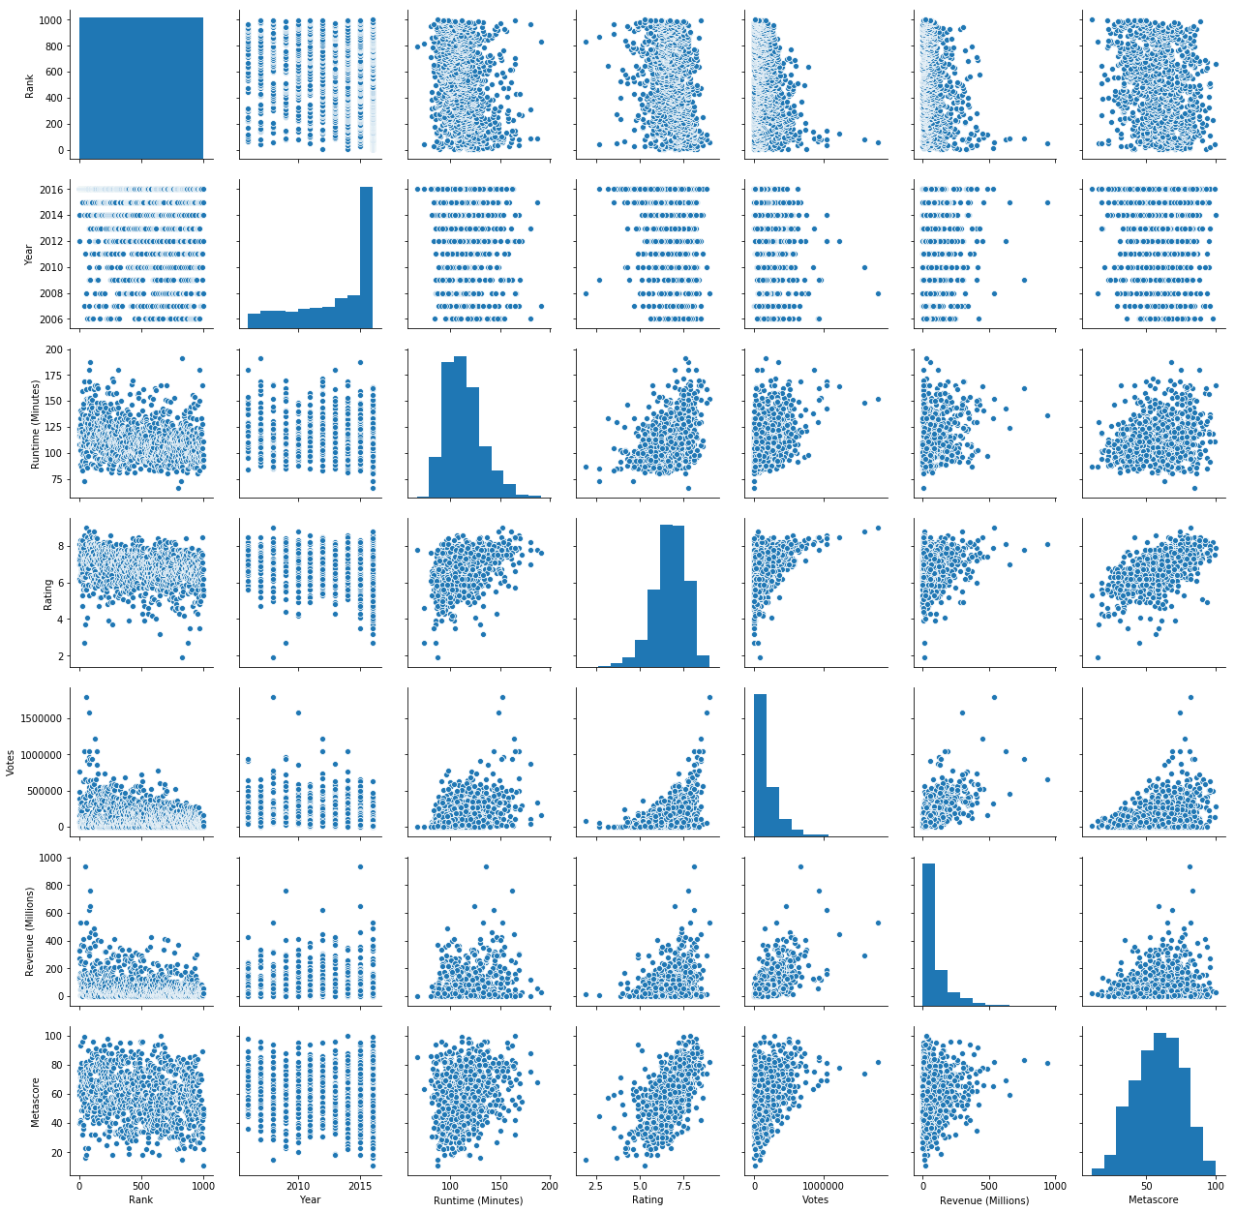
Pair plot

Slide 6
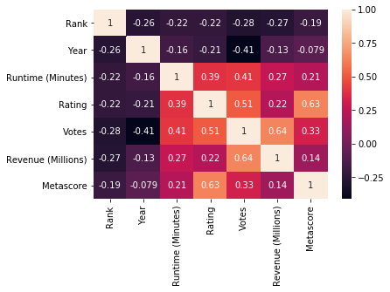
Heatmap

Slide 7
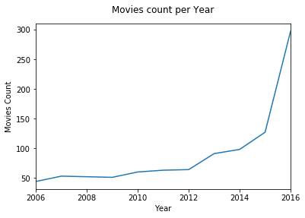
Industry Growth Y-on-y V/S Movie Count

Slide 8
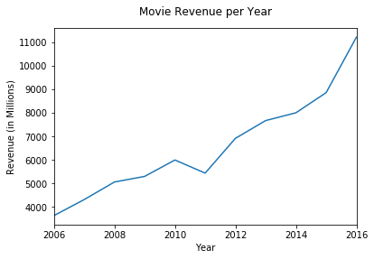
Industry Growth Y-on-y V/S Movie Revenue

Slide 9
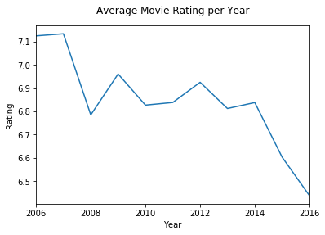
Industry Growth Y-on-y V/S Average Movie Rating

Slide 10
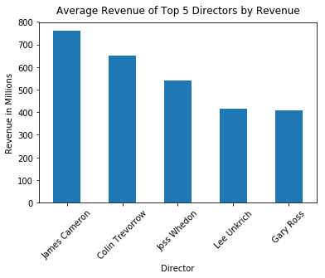
Active Director V/S Average Revenue

Slide 11
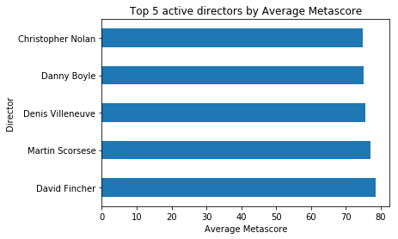
Active Director V/S Metascore

Slide 12
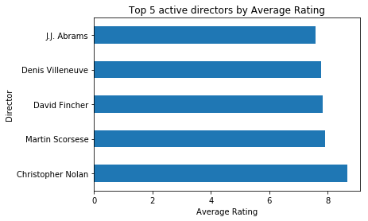
Active Director V/S Ratings

Slide 13
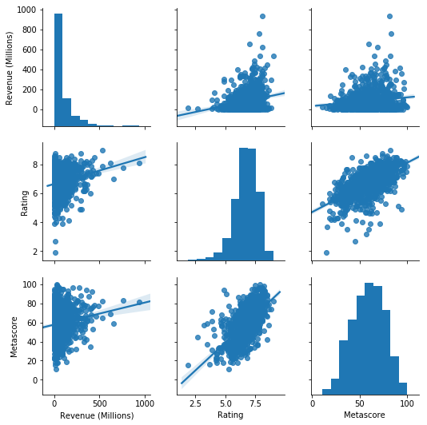
Relationship between Revenue Rating and Metascore of Movies

Slide 14
Conclusion
The movie industry is growing very fast. More movies are released year on year and the competition is very high and the revenue is distributed among many movies.
It would not be a good idea to wait for that ONE BIG MOVIE like Avatar (by James Cameron) that brings highest Revenue, Rating and Metascore . So, produce more movies using the best features for reaping the maximum benefits.
Those people who directs multiple moderately high budget movies. For instance, Christopher Nolan movies is certain to bring in more Revenue, Rating and Metascore.

Slide 15
THANK YOU

